Slide 1
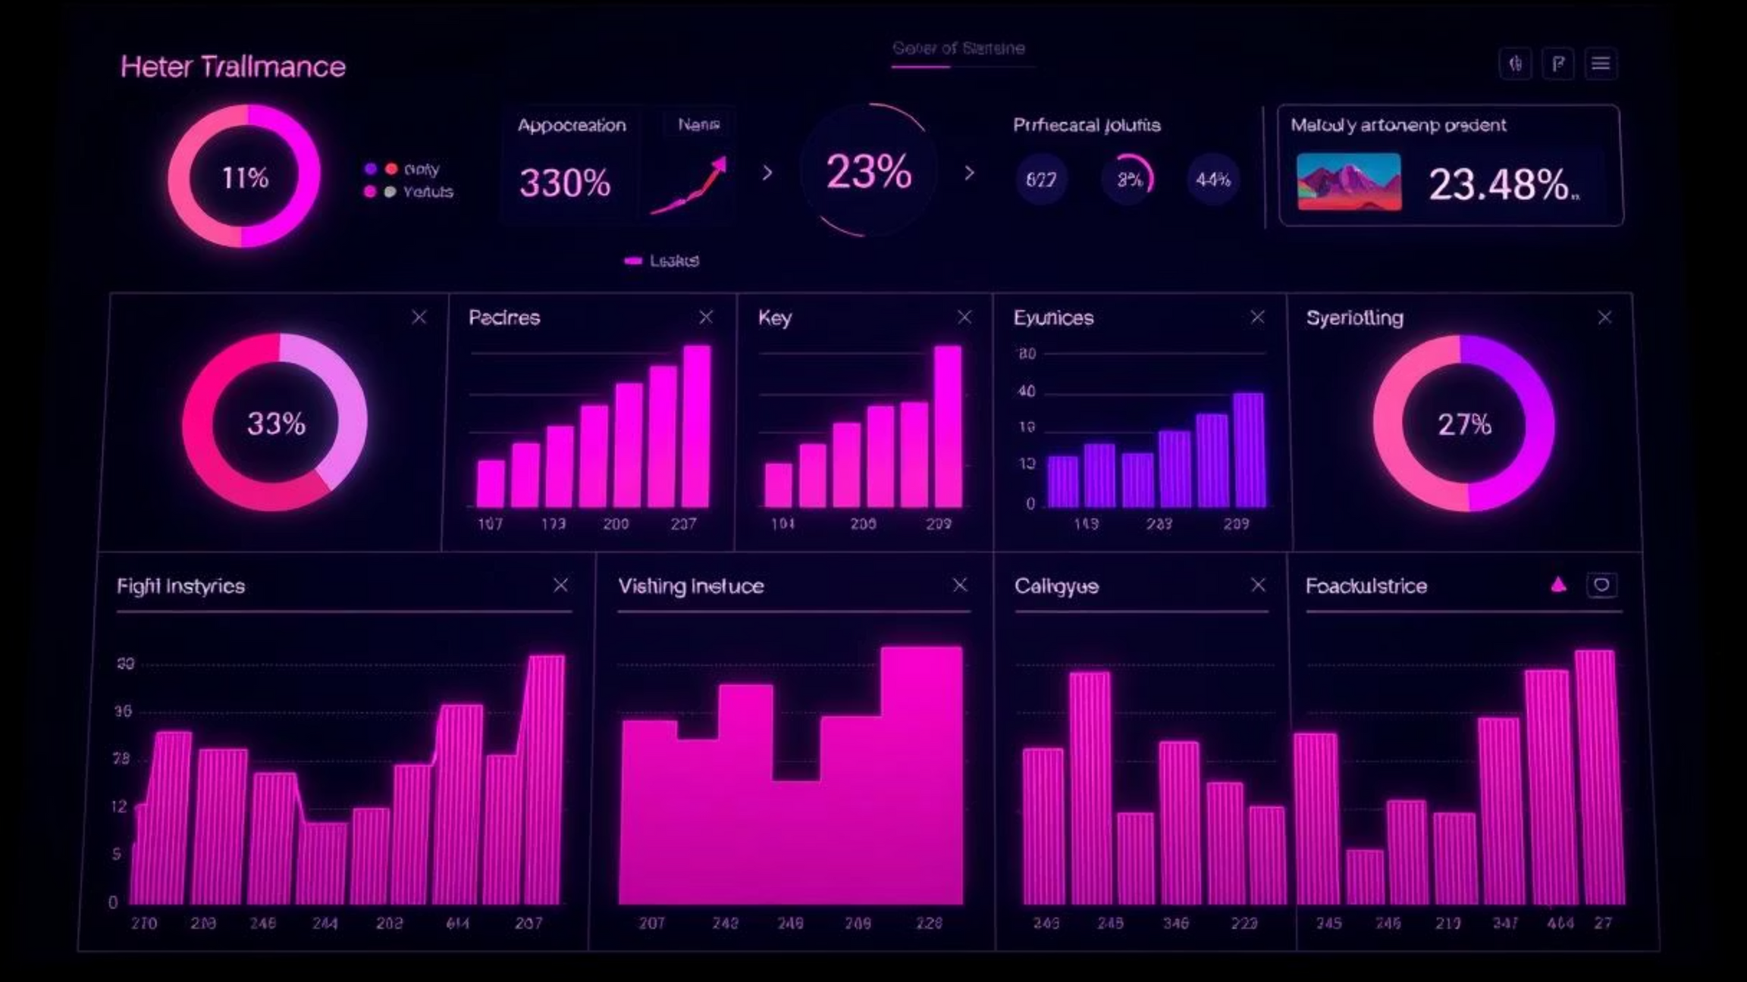
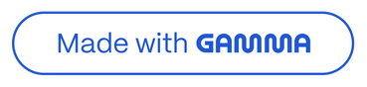
Business Performance Dashboard
Financial Analysis & KPI Monitoring
© 2025 Berlin Inc. & Kennedy Corporation

Slide 2

Key Performance Highlights
Our recent analysis reveals exceptional growth and strong performance across key metrics, driven by strategic focus areas.
1
2
3
Total Sales
Profit Margin
Growth Rate
$1.16 Million
22.62%
179.75%
Exceeding targets and demonstrating market strength.
Healthy margins reflecting efficient operations.
Exceptional year-over-year expansion.
Top Performing Segments
Leading Products
Government: 44.23%
Amarilla
Small Business: 35.74%
Carretera
Montana

Slide 3
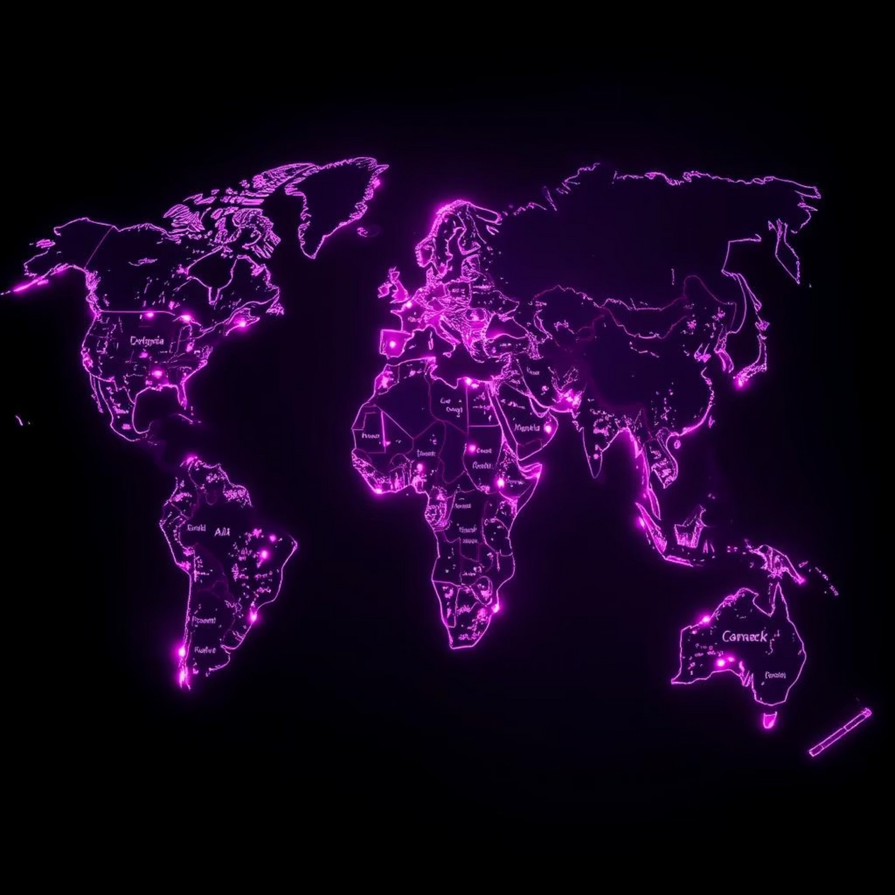
Global Sales Landscape
North America and Europe continue to be our strongest markets, contributing significantly to overall revenue.
Top Performing Countries
United States of America
Mexico
Germany
France
Canada
These countries represent the core of our current market penetration.

Slide 4
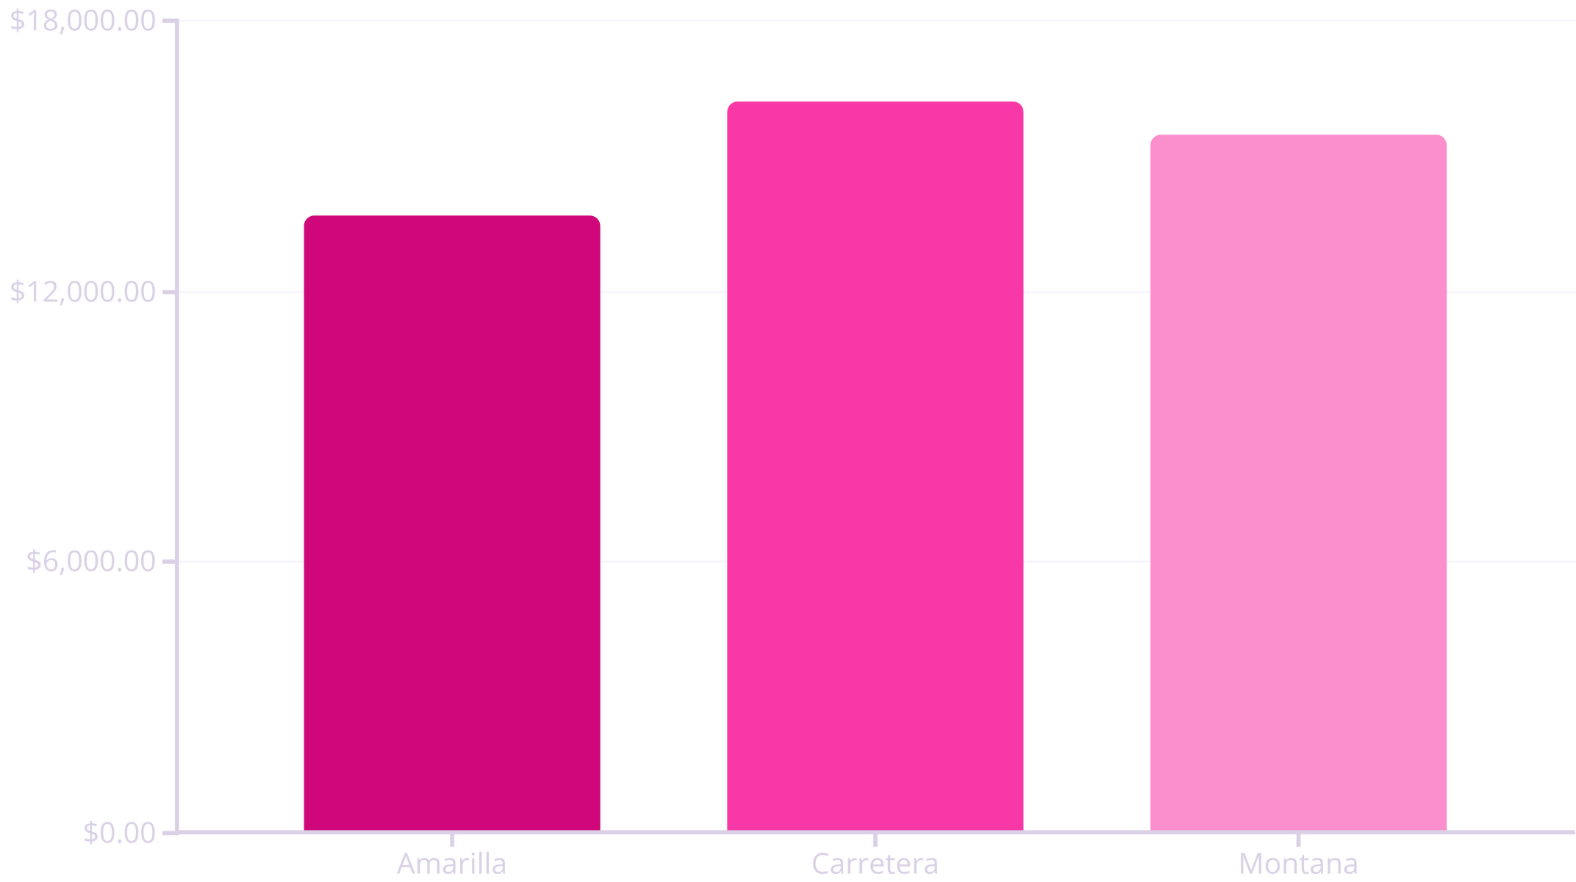
Product Performance Snapshot
"Carretera" has emerged as our top-selling product, demonstrating strong market demand and contributing significantly to sales.
This data suggests a clear leader in our product portfolio, which can guide future inventory and marketing strategies.

Slide 5
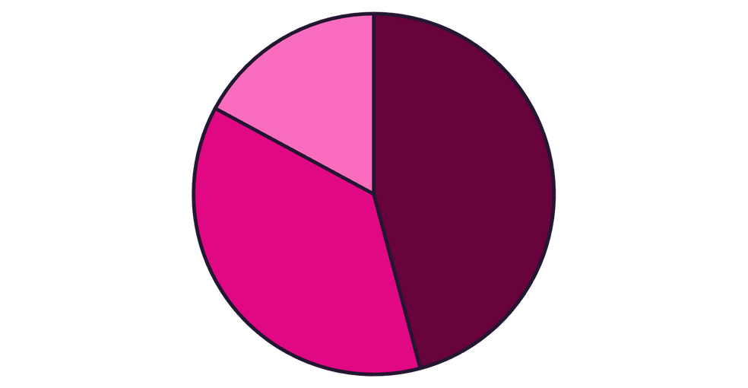

Segment Analysis: Strategic Focus
Our sales are heavily concentrated in the Government and Small Business segments, indicating robust opportunities for continued growth.
Key Segments by Sales
Government: 44.23% - Our largest segment.
Small Business: 35.74% - Significant contributor.
Enterprise: 16.52% - Growth potential to explore.
Recommendation: Maintain strong focus on Government and Small Business segments, while identifying strategies to expand within the Enterprise sector.
Government
Small Business
Enterprise

Slide 6






Unprecedented Growth
179.75%
Our year-over-year growth rate signifies robust market acceptance and effective business strategies.
Success
Scaling
Expansion
Growth
Startup
Key Growth Drivers:
High demand experienced across North America.
Expanding presence and market penetration in Europe.
Effective sales and marketing initiatives.

Slide 7
Conclusion & Strategic Actions
Our strong performance positions us for continued success. Focusing on key areas will drive future growth.
Performance Summary
Next Steps & Actions
Market Strength: Robust sales in North America, particularly USA and Mexico.
Expand Marketing
Target high-growth regions with tailored campaigns.
Segment Dominance: Government sector leads revenue contributions.
Product Leadership: "Carretera" is our top-performing product.
Optimize Product Mix
Align inventory and promotion with top-demand products.
Invest in Enterprise
Develop strategies to penetrate the Enterprise segment.

